Slide 1

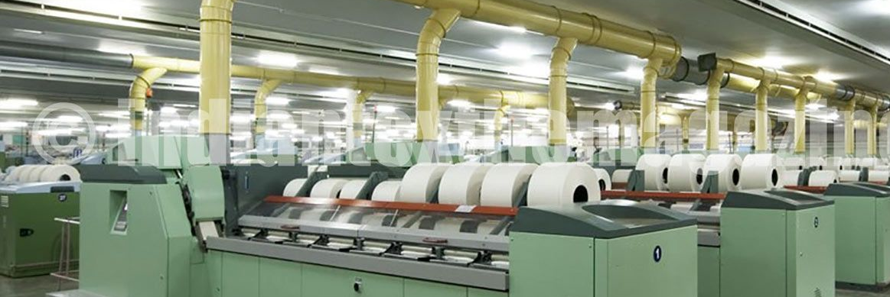
Corporate Briefing Session
Fazal Cloth Mills Limited
November 25, 2022

Slide 2
IMPORTANT DISCLAIMER
THIS PRESENTATION IS NOT AN OFFER OR SOLICITATION OF AN OFFER TO BUY OR SELL ANY SECURITIES OR ANY INVESTMENT
This presentation has been prepared by Fazal Cloth Mills Limited (FCML) solely for information purpose.
The information contained in this presentation should be considered in the context of the circumstances prevailing at the time and will not be updated to reflect any developments that may occur after the date of presentation.
During the course of this presentation we may make forward-looking statements regarding future events or the future performance of the Company. By their very nature, forward looking statements involve inherent risks and uncertainties, both general and specific and risks exist that the predictions, forecasts, projections and other forward looking statements will not be achieved.
Fazal Cloth Mills Limited does not undertake any obligation to update or revise any of them, whether as a result of new information, future events or otherwise.
When relying on forward looking statements you should carefully consider the political, economic, social and legal environment in which the Company operates.

Slide 3
Corporate Briefing – Contents
Company Brief
Operational Development
Financial Results of Year Ended June 30, 2022
Question & Answers Session

Slide 4
COMPANY BRIEF

Slide 5
Company Brief
Fazal Cloth Mills Limited (the Company) was incorporated in Pakistan in 1966 as a public limited company under the Companies Act, 1913 (now the Companies Act, 2017) and its shares are quoted on Pakistan Stock Exchange.
The Company is principally engaged in manufacturing and sale of Yarn & fabric. The manufacturing facilities are located at Fazal Nagar, Jhang Road, Muzaffargarh and Qadirpur Rawan Bypass, Khanewal Road, Multan in the province of Punjab.
Head Office of the Company is situated 59/3, Abdali Road Multan.
Registered Office is situated at 69/7, Abid Majeed Road, Survey No. 248/7, Lahore Cantt, Lahore.
Imperial Textile Mills Limited, a wholly owned subsidiary of the company, has been merged with the company during the year.

Slide 6
Company Brief
The Associated Companies, their shareholding as held by the company and nature of business is below;
  Fatima Transmission Company Limited (Operation & maintenance of Transmission lines etc.)
  Ordinary Shares – Unquoted 24.00% (2021: 24.00%)
Non-voting preference shares – Unquoted 30.71% (2021: 0.00%)
  Fatima Electric Company Limited (Supply, generation and distribution of electricity etc.)
  Ordinary Shares – Unquoted 20.00% (2021: 20.00%)

Slide 7
Operations / Business

Slide 8

Operations / Business
Brief of Operations
The spinning division of the Company comprises of 8 spinning units with installed capacity of 274,524 spindles. All of the spinning units are equipped with state of art Japanese and European machinery.
No. of rotors and MVS (Murata Vortex Spinning) spindles installed are 5,412.
Capacity at 20’s counts are 127,222,563 Kgs / annum and actual production of all count is 100,859,557 Kgs / annum.
The Weaving unit of the Company consist of 224 Air-jet looms with actual production of 45,369,887 Meters of Greige fabric per annum. With combination of state of the art weaving equipment, technical know-how and managerial expertise the weaving unit of the company ensures quality production and services to customers.

Slide 9
Operations / Business
Brief of Operations
Total No. of employees as at June 30, 2022 are 6,934.
Power Plant Capacity is 54.06 Mega Watts.

Slide 10
Financial Highlights of Year Ended
June 30, 2022

Slide 11
Financial Highlights
Profit & Loss for period ended June 30, 2022
Financial Highlights | 2022 | 2021 | Increase / (decrease)
 | Rupees in (‘000’) | Rupees in (‘000’) | % Age
Sales – Net | 65,406,261 | 52,132,242 | 25.46%
Cost of sales | 54,238,313 | 44,127,252 | 22.91%
Gross profit | 11,167,947 | 8,004,989 | 39.51%
EBITDA | 10,485,539 | 8,793,472 | 19.24%
Depreciation | 1,664,133 | 1,436,003 | 15.89%
Finance cost | 2,922,661 | 1,794,692 | 62.85%
Other income | 561,256 | 644,455 | -12.91%
Profit before tax | 5,898,745 | 5,562,778 | 6.04%
Profit after tax | 4,610,255 | 5,431,757 | -15.12%
Earnings per share – Rs. | 153.68 | 181.06 | -15.12%

Slide 12
Financial Highlights- Profit & Loss
Turnover- Trend Seven years

Slide 13
Financial Highlights- Profit & Loss
Profit after tax - Trend Seven years

Slide 14
Financial Highlights- Profit & Loss
Earning per share-Trend Seven years

Slide 15
Financial Highlights- Balance Sheet As at 30 June
Particulars | 2022 …Rs… | 2021 …Rs…
Non-current Assets | 49,028,575,173 | 44,369,695,531
Current Assets | 38,514,327,251 | 22,754,410,084
Total Assets | 87,542,902,424 | 67,124,105,615
Equity | 40,529,294,748 | 34,697,283,259
Long-term Liabilities | 20,398,932,173 | 17,717,131,724
Current Liabilities | 26,614,675,503 | 14,709,690,632
Total Equity & Liabilities | 87,542,902,424 | 67,124,105,615

Slide 16
Operations / Business
Future Outlook
Demand for yarn and fabric remains strong and margins are reasonable albeit lower than last year due to absence of inventory gains. Historically high prices of raw materials this year pose increased risk of loss in case of any downward movement in prices. Your management is trying to reduce this risk by carrying less inventory and selling as much yarn/fabric as possible.
GOP continues to provide energy at regionally competitive tariffs to the textile industry. Inshallah, if this sensible policy continues, textile business in Pakistan will continue to thrive and exports will increase. Due to shift of demand from China to other countries, ample opportunity exists for Pakistan to increase its market share.
BMR and expansion of the Company’s different units continues to benefit from increased demand. During the current year, your company expects to invest approximately Rs.5 billion for BMR and expansion.

Slide 17
THANK YOU

